Slide 1
Smart automatic fish feeder team members k.shanmukha priya reg no:192011233 n.shailaja reg no:192011163 guide dr.v. karthick

Slide 2
introduction
Fish feeder is to feed fish food from time to time in absence of owner.
We can feed food in 8 or 12 intervals of time only.
Only limited food can be feeded to the fish.
Excess of food and uneaten food can pollute water and can create high ammonia and lower the oxygen levels as well as lowering the hp levels.

Slide 3
discription
If we are away from home during feeding times automatically it will feed food to fish.
We have frequent work trips or may go out in case of emergency.
These feeder will drop food into the aquarium.
Because overfeeding clogs the filter And breaks down into toxins that are harmful to fish.

Slide 4
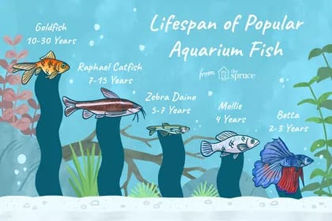

Slide 5
Components
Arduino Nano Integrated development environment(IDE)
Servo motor
Wires
Male and female part
Switch
Battery holder
Battery(18650 LITHIUM ION)
Flex kwik
Charger

Slide 6
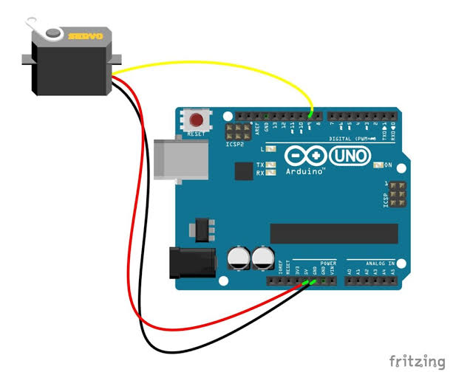
Connection of servo motor with arduino

Slide 7
WORKING
We are going to set the time 8 or 12 hours intervals of time.
So initially when it reach the Morning the container rotates and automatically it dispenses the food to fish.
It has three strings ‘Morning’, ’Afternoon’ and’Evening’.
The same procedure is going to repeat in the Afternoon and Evening as the time reaches.

Slide 8
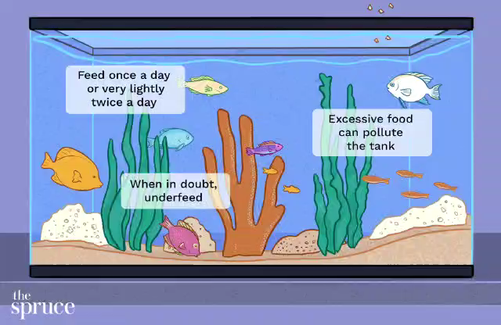

Slide 9
Existing FEATURES
We can set our desired feeding intervals of 8 or 12 hours.
Large amount of food can be feeded in the container.
By using wifi connection we can get notification whether the fish is feeded the food or not.
If we are away from fish aquarium we cant know that the fish is feeded or not .so we are using mobile application technique.
We can also use sensor method to feed fish.

Slide 10
Program:
#include<servo.h>
Servo servo;
Void set up()
{
servo.attach(2);
Servo. Write(0);
Delay(2000);
}
void loop()
{
Servo. Write(100);
Delay(10,000);
Servo. Write(0);
delay(1000);

Slide 11
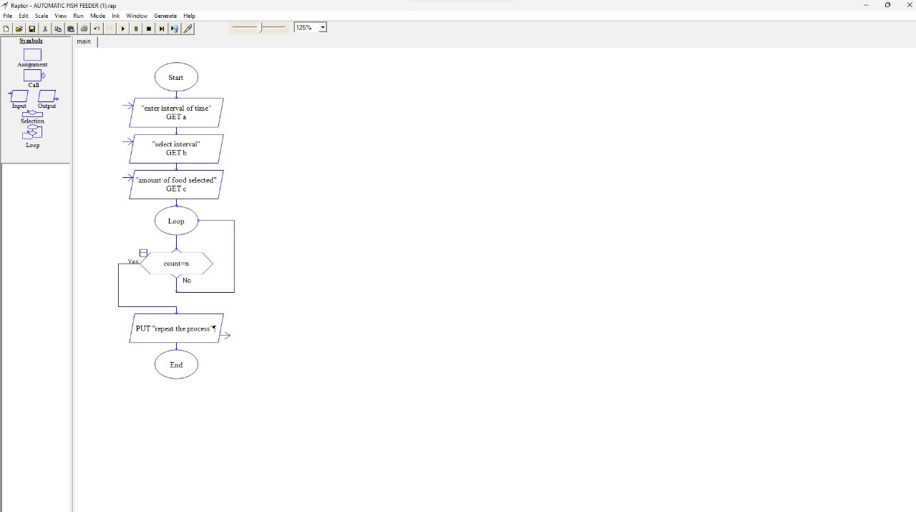
Flow chart

Slide 12
advantages
Feeding distance and feeding area and feeding time can be adjusted
Automatic Fish Feeders Are Reliable
It gives correct quantity of food in given time.
It saves our time.

Slide 13
disadvantages
We cant give excess of food .
Water pollution.
Ecosystems are altered .
Fish farming is quite inefficient.
Adverse health effects for humans.

Slide 14
Thank you

